Slide 1
CodeX and RGB
Setting pixels to any color using RGB tuples

Slide 2
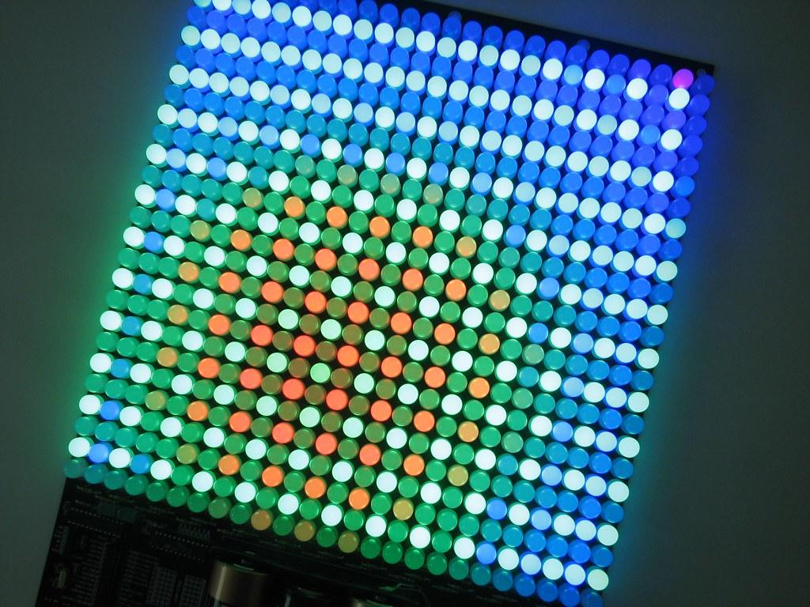
What is RGB?
RGB stands for Red, Green, Blue.
Find out more by watching the short video on the next slide.

Slide 3
Code.org video on pixels
Watch from
0:45 to 2:35
Notes:
Link to Youtube video: https://www.youtube.com/watch?v=15aqFQQVBWU&t=8s

Slide 4
Getting RGB values
The video mentions triplets of numbers.
In Python, the triplet is called a tuple.
Each number in the triplet (or tuple) represents a value in RGB.
= ( 47, 147, 181)
The first number is the amount of red
The second number is the amount of green
The third number is the amount of blue

Slide 5
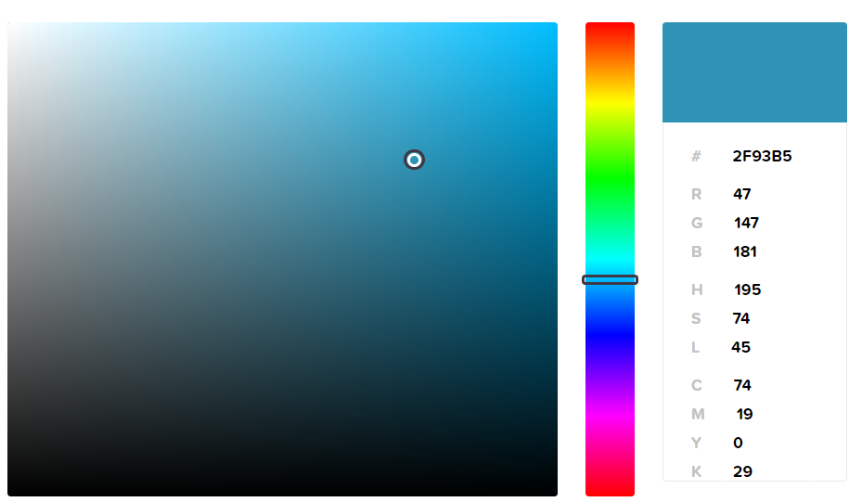
Getting RGB values
Use online software to select a color and find the RGB colors.
(47, 147, 181)
Notes:
Link to color picker software: https://htmlcolorcodes.com/color-picker/

Slide 6
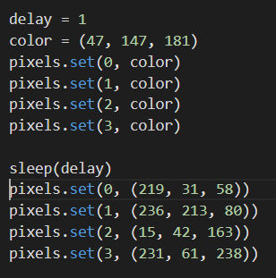
Using RGB values
Set your own colors by changing the color value to a tuple instead of a built-in color:
color = (47, 147, 181)
You can do this throughout the program, as often as you want. Or set the value in the pixels.set command.

Slide 7
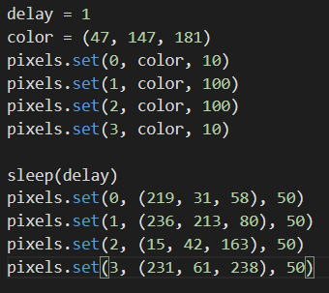
Using RGB values
You can add a third value in the pixels.set() command, which determines the brightness.
Brightness values are from 0 to 100

Slide 8
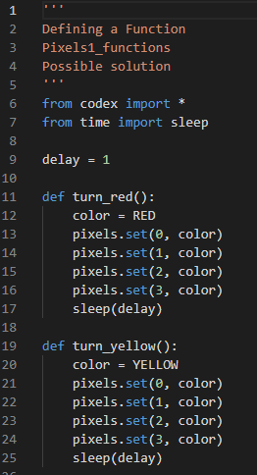
RGB – Part 1
Open the Pixels1_functions program from the last lesson. Use the sandbox!
Save the program as Pixels1_RGB
Use “Save As…”

Slide 9
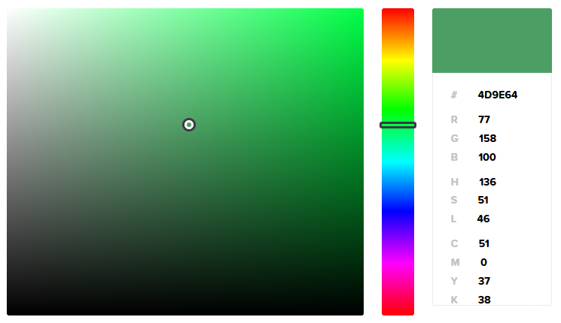
RGB – Part 1
Pick a color using the color-picker software.
Identify the RGB triplet.
The RGB triplet is also called a tuple in Python. A tuple is like a list with values that don’t change.

Slide 10
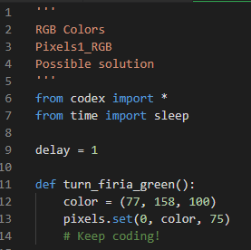
RGB – Part 1
Define a new function that will light the pixels a color you define using a tuple.
Name the function the color you selected.
Code the function to turn all pixels that color.
Include a third argument for the brightness

Slide 11
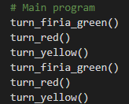
RGB – Part 1
Call the function at least once in the main program.
Run the program and make sure the code works properly.

Slide 12
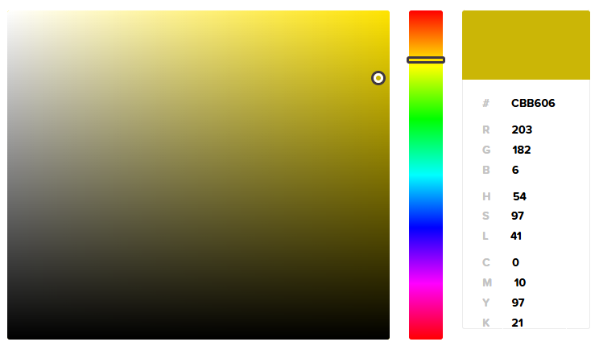
RGB – Part 2
Pick another color using the color-picker software.
Identify the RGB triplet.
Add another function to your code for this color.

Slide 13
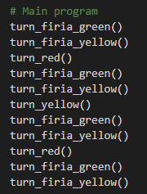
RGB – Part 2
Call the function at least once in the main program.
Run the program and make sure the code works properly.

Slide 14
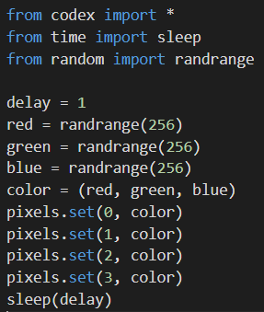
RGB – Part 3 Random RGB values
If you want to try something new, generate random numbers for R, G and B and see what color happens!
Everytime you run the code, you should get a different color.

Slide 15
RGB – Part 3 Random RGB values
A new library is needed for
random values.
The random library has several functions. The one you will use today is randrange().
It will generate a random value between 0 and up to but not including the number in parenthesis.
So randrange(256) will generate a number between 0 and 255, the range of RGB colors!

Slide 16
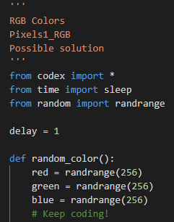
RGB – Part 3
Define a new function that will light the pixels a random color.
Name the function the color you selected.
Code the function to turn all pixels the same random color.
Optional: Include a third argument for the brightness

Slide 17
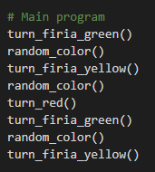
RGB – Part 3
Call the function at least once in the main program.
Run the program and make sure the code works properly.

Slide 18
Are you ready for a challenge?
If you have time, try one (or more) of these challenges. They can be completed in any order.

Slide 19
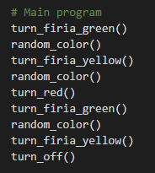
Challenge #1
Do you see that the pixels stay on after the program ends?
Define a function that will turn off the pixels (color = BLACK).
Then call the function at the end of the main program.

Slide 20
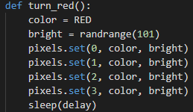
Challenge #2
You generated random numbers for the RGB colors. What about a random brightness?
Select an already-defined function for a color.
Add a variable for brightness, and assign its value by generating a random number between 0 and 100.
Use the variable in the pixels.set() command.

Slide 21
Challenge #3
Right now all the pixels are the same color.
Define a function that will set all four pixels to different colors.
There are many different ways to do this:
Use the pre-defined colors instead of a variable in each pixels.set()
Use tuples instead of a variable in each pixels.set()
Get a random color for each pixel
Or any combination of these suggestions.

